Slide 1
Process Multiply Cameras with OpenCV
Revision History: April 12 2017
Created by: Eric Lan
Advisor: Dr. Harry Li
CMPE 195: Senior Project
Team Member: Michael Josh Dangcil, Eric Lan, James Medel, Chris Peng, Dennis Simon

Slide 2
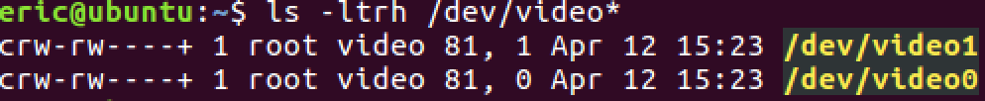
Access multiple Camera Streams at Once
First of all, to check all available video devices:
In this case, video0 is my built in webcam, and video1 is external webcam.
Device# is needed later in the program.

Slide 3
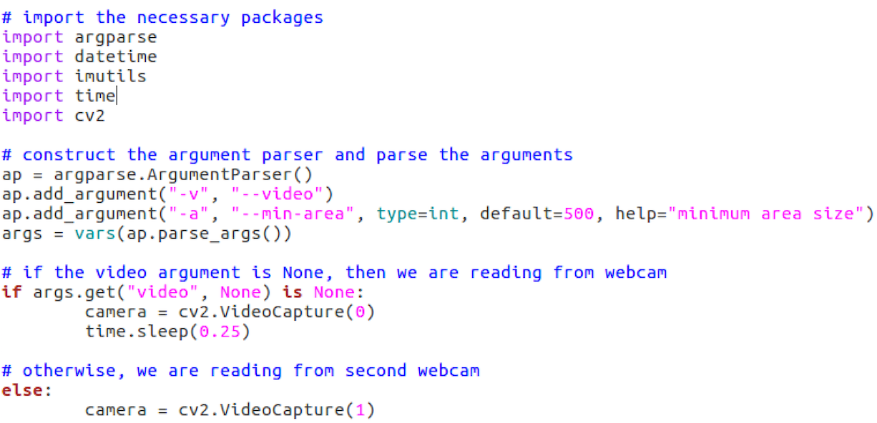
Access multiple Camera Streams at Once
Then, construct the parser
Parse command line arguments
Video0 is used here.
Video1 is used here.

Slide 4
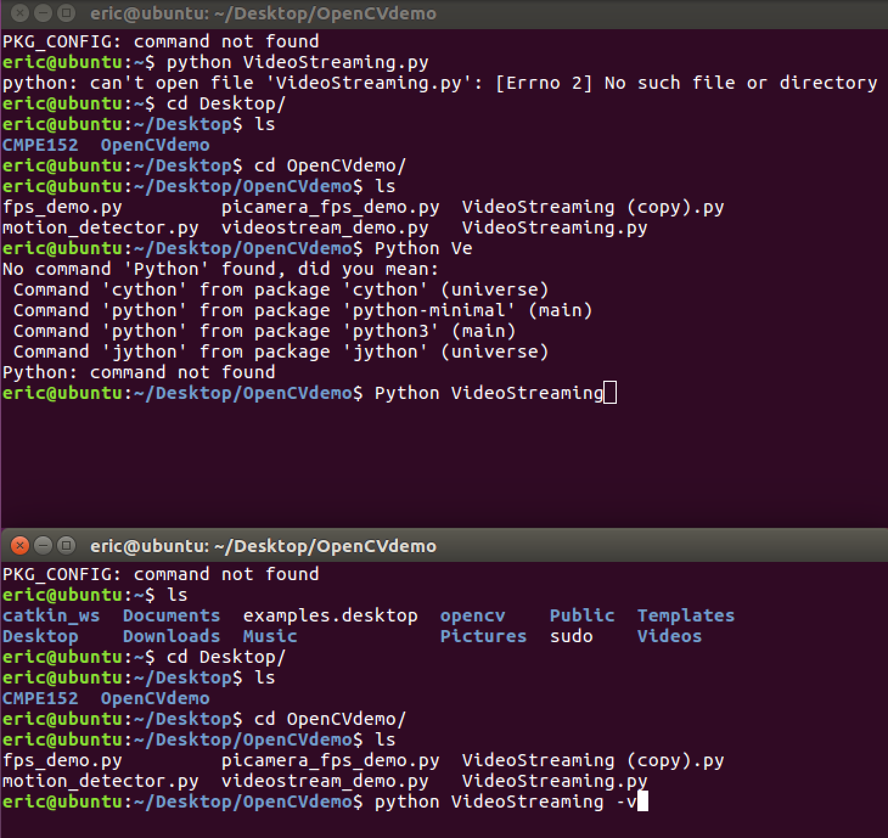
Threaded video stream
When Second Terminal is trying to access
the other webcam, a threaded video
stream is created and handled by CPU.
To generate threaded video streaming
Camera = cv2.videocapture();

